Slide 1
Cluster Cryptos by Behavior
Data Science and Machine Learning: ML Group 10
Machine Learning Analysis of Cryptocurrency Markets
Data Science Initiative Project
Dataset Period: 2013-2018
Cryptocurrencies Analyzed: 1,383
Clustering Quality: 99.2%
Aya Abu Allan Anitha Aravindaraman Puneet Arora Tom Konikkara Xavier Redhead

Slide 2
As of 2024, over 23,000 cryptocurrencies exist—but more than 80% have little to no active trading volume or utility.
(Source: CoinMarketCap, archived data)

Slide 3
Business Motivation
THE CHALLENGE:
• Market Complexity: Thousands of cryptocurrencies with different behaviors
• Investment Confusion: Difficult to choose beyond Bitcoin and Ethereum
• Risk Assessment: Lack of structured approach to evaluate risk profiles
• Volatility Management: Need for systematic risk management tools
THE OPPORTUNITY:
• For Investors: Better understand risk-return profiles
• For Exchanges: Create diversified product offerings
• For Portfolio Managers: Design targeted investment strategies
• For Researchers: Study altcoin trends and market anomalies
• For Developers: Build better trading and analysis tools

Slide 4
Dataset Overview & Data Quality
DATA SOURCE: All Crypto Currencies Dataset (Kaggle - JesseVent)
COVERAGE:
• Time Period: April 28, 2013 - November 30, 2018 (2,042 days)
• Raw Records: 942,297 → Cleaned: 879,375 (93.3% retained)
• Cryptocurrencies: 2,071 → Filtered: 1,383 (≥180 days trading)
• 13 Original Features → 7 Engineered Features for clustering
DATA QUALITY CONTROLS:
• Removed invalid price relationships
• Handled 63 duplicate symbols
• Filtered low-activity coins (minimum 180 days)
• Created year-wise datasets for temporal analysis
VISUALIZATION: data_preparation.ipynb shows distribution patterns

Slide 5
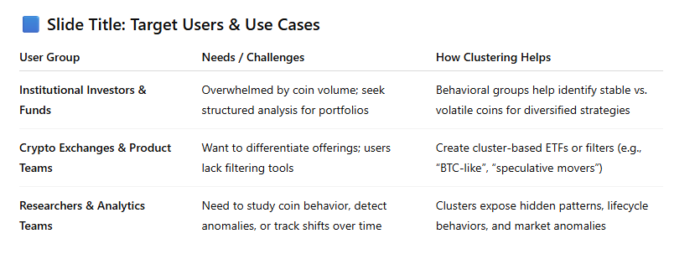
Technical Implementation & Workflow
NOTEBOOK STRUCTURE:
1. data_preparation.ipynb - Data cleaning and preprocessing
• Quality control and filtering
• Year-wise data segmentation
• Data availability analysis
2. feature_engineering.ipynb - Feature creation and clustering
• 7 behavioral features engineered
• K-means clustering (k=5) with 0.992 silhouette score
• PCA visualization and cluster profiling
3. investment_insights.ipynb - Analysis and recommendations
• Risk assessment framework
• Investment strategies by profile
• Portfolio diversification approaches
4. knn_30day_risk_profile.ipynb - Dynamic risk profiling
• 30-day rolling risk snapshots
• Temporal risk cluster analysis

Slide 6
Feature Engineering Details
Feature | Description | Purpose
Average Daily Return | Mean of daily price changes | Performance metric
Volatility | Standard deviation of returns | Risk measurement
Sharpe Ratio | Risk-adjusted returns | Efficiency metric
Maximum Drawdown | Worst peak-to-trough decline | Downside risk
Bitcoin Correlation | Correlation with BTC returns | Market beta proxy
Price Range | High-low price ratio | Trading range
Volume Stability | Coefficient of variation | Liquidity measure

Slide 7
Clustering Methodology & Optimization
CLUSTERING APPROACH:
• K-Means Clustering with RobustScaler (handles outliers)
• Hierarchical Clustering for validation
• PCA for 2D visualization
OPTIMAL CLUSTER SELECTION:
• Elbow Method: Analyzed inertia vs k (2-10 clusters)
• Silhouette Analysis: Measured cluster separation quality
• Result: k=5 optimal with 0.992 silhouette score
VALIDATION METRICS:
• Silhouette Score: 0.992 (Excellent separation)
• Visual validation through PCA plots
KEY VISUALIZATIONS:
→ Elbow plots: feature_engineering.ipynb (cell: 93546be7)
→ PCA clusters: feature_engineering.ipynb (cell: 6814a24a)
→ Risk elbow: knn_30day_risk_profile.ipynb (cell: 5210686d)

Slide 8
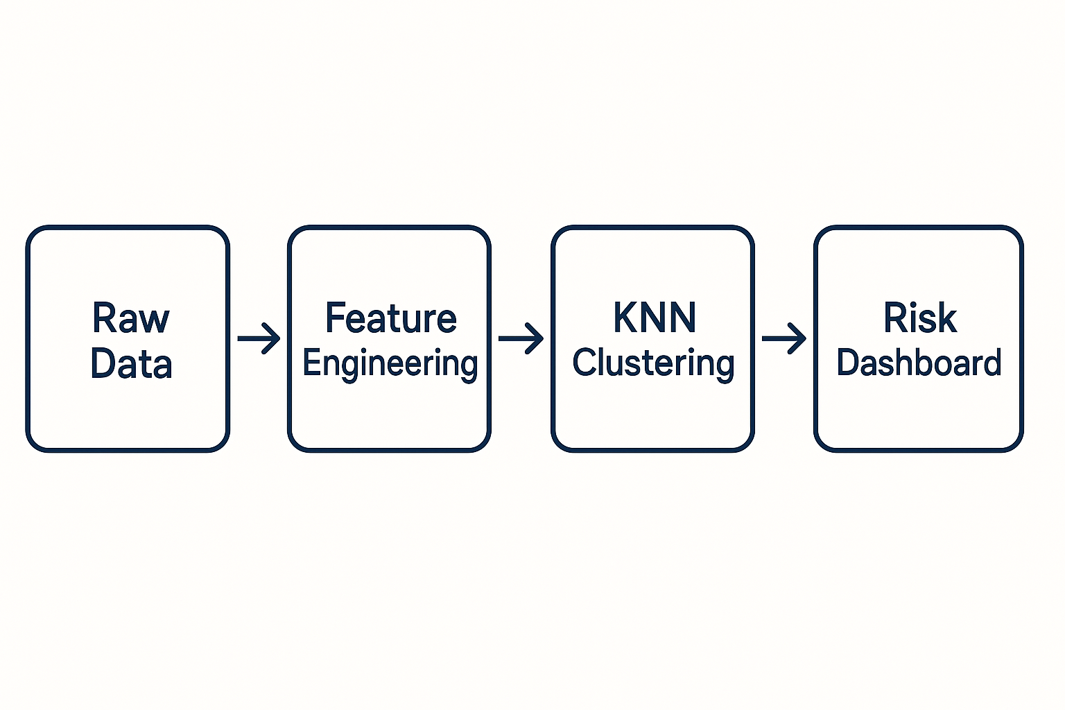
Clustering Results & Distribution
Processed historical price and technical data for 100+ coins across time windows
We extracted signals: volatility, spreads, momentum, liquidity
We then grouped coins into risk-based clusters using unsupervised learning
Cluster | Size | Percentage | Characteristics | Notable Coins
Cluster 0 | 1,378 | 99.6% | Main diverse group | Bitcoin, Ethereum, Litecoin
Cluster 1 | 1 | 0.07% | Moderate outlier | Dix Asset
Cluster 2 | 1 | 0.07% | Extreme returns | AllSafe
Cluster 3 | 1 | 0.07% | Highest volatility | Veritaseum
Cluster 4 | 2 | 0.14% | High risk/return | Global Crypto, STEX
Notes:
We processed historical price and technical data for 100+ coins across time windows.
We extracted signals: volatility, spreads, momentum, liquidity.
We then grouped coins into risk-based clusters using unsupervised learning.

Slide 9
Risk Assessment Framework
RISK CATEGORIZATION (Based on Daily Volatility):
• Low Risk: < 3% daily volatility (4 coins - 0.3%)
• Medium Risk: 3-5% daily volatility (3 coins - 0.2%)
• High Risk: 5-8% daily volatility (47 coins - 3.4%)
• Very High Risk: > 8% daily volatility (1,329 coins - 96.1%)
EXTREME RISK RANGE:
• Minimum Volatility: 0.0101 (daily)
• Maximum Volatility: 2,969.19 (daily)
• Range Difference: 295,000x variation in risk levels
RISK SCORING SYSTEM:
• Normalized 0-100 risk scores for comparison
• Bitcoin correlation as stability indicator
• Maximum drawdown for downside risk assessment
KEY INSIGHT: 96% of cryptocurrencies are very high risk
Risk visualization: investment_insights.ipynb (cell: 3790f6bc)

Slide 10
Investment Recommendations by Profile
Describe the model and evaluator decisions
Profile | Suitable Coins | Top Recommendations | Strategy Notes
Conservative | 0 coins | Consider stablecoins | Very limited crypto options
Moderate | 1 coin | Colu Local Network | Careful position sizing
Aggressive | 206 coins | Stratis, Ethereum | Focus on return/risk ratio
Speculative | 1,153 coins | MACRON, JavaScript Token | Accept extreme volatility

Slide 11
Portfolio Diversification Strategies
1. CLUSTER-BASED DIVERSIFICATION:
• Equal allocation across behavioral clusters (20% each)
• Reduces concentration risk through behavior diversity
2. RISK-TIERED PORTFOLIO:
• 50% Low Risk, 30% Medium, 15% High, 5% Very High Risk
• Pyramid allocation approach
3. CORE-SATELLITE STRATEGY:
• 70% in established coins (Bitcoin, Ethereum)
• 30% in selected altcoins for growth potential
4. BITCOIN-CORRELATION BASED:
• High correlation (>0.7): Market followers
• Medium correlation (0.3-0.7): Balanced exposure
• Low correlation (<0.3): True diversification
Performance comparison: investment_insights.ipynb (cell: 1dfdb584)

Slide 12
Dynamic Risk Profiling
30-DAY ROLLING RISK ANALYSIS:
• 90-day window updated every 30 days
• Tracks how coin risk profiles evolve over time
• Analyzed top 50 cryptocurrencies by market cap
6 RISK CATEGORIES IDENTIFIED:
• Low Risk / High Market Cap / Low Return
• Medium Risk / Moderate Volatility / Negative Return
• Medium-High Risk / High Volatility / Positive Return
• High Risk / High Volatility / Strong Positive Return
• High Risk / Microcap Movers / Spiky Volume
• Low Risk / Low Liquidity / Outlier Spread
KEY FINDINGS:
• Risk profiles are dynamic and change over time
• Bitcoin showed 12 cluster transitions
• Highest Sharpe ratio: High Risk/High Return cluster (2.71)
Visualizations: knn_30day_risk_profile.ipynb (cells: 10756216, c811dbca)

Slide 13
Market Condition Strategies
What went wrong? What we do differently
No ground truth/ lack of domain knowledge
Nature of market to follow favoured coins
Add more recent data through API
Segment by rolling window
Other clustering algos: DBSCAN, Agglomerative, HDBSCAN…
Market Condition | Recommended Clusters | Strategy | Risk Management
Bull Market | Clusters 2, 3 | Increase growth allocation 20% | Trailing stop losses
Bear Market | Cluster 0 | Focus on established coins | Dollar-cost averaging
High Volatility | All clusters | Reduce position sizes | Wider stop losses
Consolidation | All clusters | Accumulate quality projects | Set breakout alerts

Slide 14
Risk Management Guidelines
POSITION SIZING BY RISK LEVEL:
• Low Risk: Max 10-15%, Stop Loss 5-10%
• Medium Risk: Max 5-10%, Stop Loss 10-15%
• High Risk: Max 2-5%, Stop Loss 15-20%
• Very High Risk: Max 1-2%, Stop Loss 20-25%
DIVERSIFICATION RULES:
• Minimum 10-15 different cryptocurrencies
• No more than 20% in any single coin
• At least 3 different clusters represented
• Maximum 40% in high correlation (>0.8) coins
REBALANCING FREQUENCY:
• Conservative: Quarterly
• Moderate: Monthly
• Aggressive: Bi-weekly
• Speculative: Weekly
EXIT STRATEGIES:
• Set 2:1 risk/reward targets
• Use trailing stops on winners
• Cut losses quickly, review strategy monthly

Slide 15
Interactive Dashboard & Visualizations

Slide 16

Key Insights & Findings
MAJOR DISCOVERIES:
• 5 distinct behavioral clusters with 99.2% clustering quality
• 96% of cryptocurrencies classified as very high risk
• Bitcoin correlation varies from -0.091 to 1.000
• Volatility range: 0.01 to 2,969 (295,000x difference)
• Top 10 coins represent significant market cap concentration
INVESTMENT IMPLICATIONS:
• Conservative investors have extremely limited options
• Diversification across clusters significantly reduces risk
• Risk management is absolutely critical
• Dynamic risk monitoring needed
TECHNICAL ACHIEVEMENTS:
• Successfully processed 879,375 daily records
• Created comprehensive risk assessment framework
• Built interactive analysis dashboard
• Generated actionable strategies for 4 investor profiles
• Achieved excellent clustering quality with clear separation

Slide 17
Project Outcomes & Deliverables

Slide 18
Future Enhancements & Extensions

Slide 19
Conclusions & Recommendations

Slide 20
Questions & Discussion

